Slide 1

Capitalism vs Socialism
Junaid Ali
Amur Pal
Sannan Zia
M. Hassan
Shahzaib Ahmed Hassan

Slide 2
1
Introduction
2
History
3
Different Forms/Types
4
Pros and Cons
Table of Contents
5
Modern Era
6
Economic system of Pakistan
7
Suggestions
8
Summary

Slide 3
Introduction
Capitalism
Pakistan's economic system
Economic system characterized by private ownership and profit-driven production.
Pakistan has a mixed economy with private enterprise and government regulation and ownership.
Pakistan's economy is agriculture-based, but it is rapidly industrializing and urbanizing. It is currently the 23rd largest economy in the world.
Pakistan's economic system has faced challenges, including poverty, inequality, political instability, and corruption.
Socialism
Economic system characterized by state or community ownership and wealth distribution according to need.

Slide 4


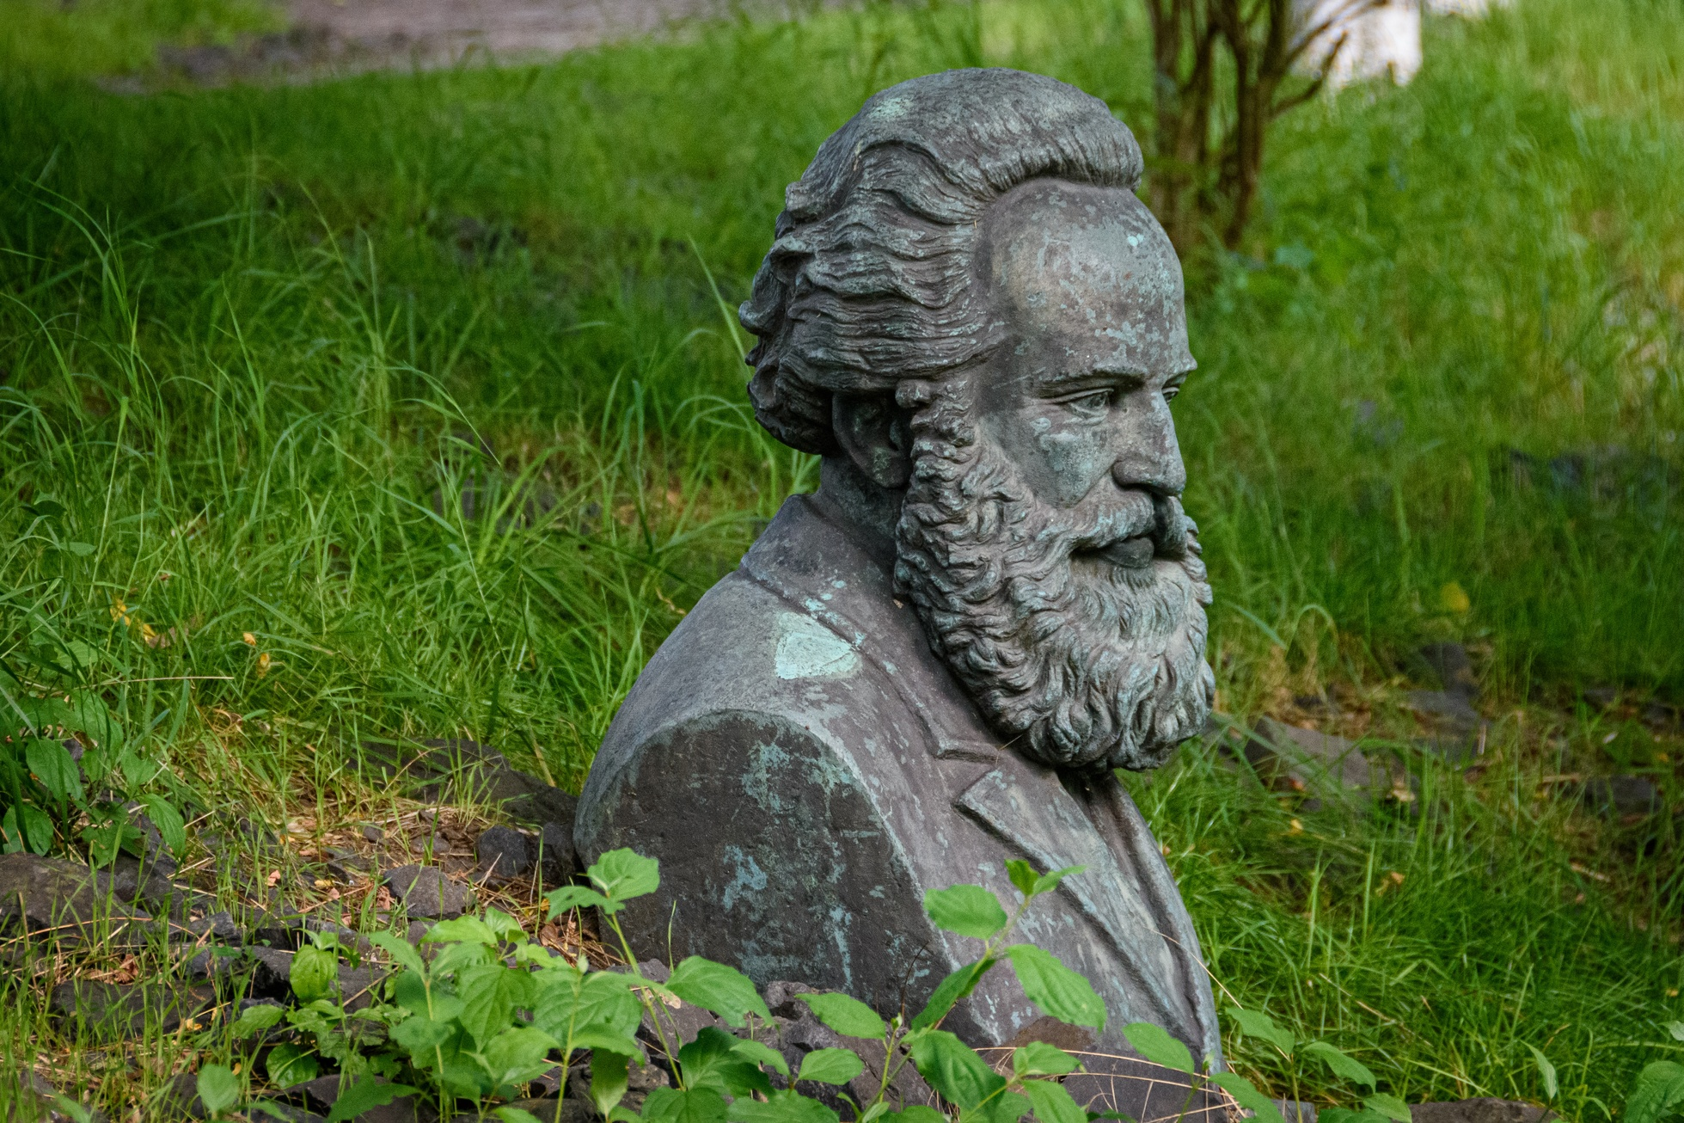
Historical Aspect
Capitalism
Capitalism has roots in 16th and 17th century Europe and was fueled by industrialization in the 18th and 19th centuries. It is characterized by private ownership and the pursuit of profit.
Key figures in the development of capitalism include Adam Smith, John Locke, and David Ricardo.
Adam Smith
Socialism
Socialism emerged in the 19th century as a response to the inequities of capitalism. It advocates for collective ownership and distribution with the goal of creating a more equitable society.
Key figures in the development of socialism include Karl Marx, Friedrich Engels, and Vladimir Lenin.
Karl Marx

Slide 5

Different Forms of Capitalism and Socialism
Capitalism
Laissez-faire capitalism
characterized by minimal government intervention in the economy and a focus on free market principles.
State capitalism
a high degree of government intervention in the economy, including regulation, subsidies, and state ownership of key industries.
Mixed economies
Combining elements of capitalism and socialism
The government plays a role in regulating the economy and providing certain public goods and services, while private enterprise and individual ownership are also allowed.

Slide 6

Different Forms of Capitalism and Socialism
Socialism
Communist Socialism
Advocates for complete overthrow of capitalism
Goal of establishing classless, stateless society based on common ownership of means of production
Democratic Socialism
Seeks to transition from capitalism to socialism through democratic means
Advocates for greater role for state in regulating economy and providing public goods and services
Allows for private enterprise and individual ownership to continue
Mixed Socialism
Combines elements of socialism and capitalism
Means of production are collectively owned, but prices determined by market forces
Aiming for more equitable and efficient economic system

Slide 7
Analysis of the Two System
Capitalism vs Socialism
Capitalism
Capitalism
Pros
Cons
Economic growth
Capitalism encourages innovation and hard work, which can lead to economic growth and development
Individual incentive
Incentive for individuals to work hard and be innovative
Personal freedom
Capitalism allows for a greater degree of individual freedom and choice, as people are free to start their own businesses and make their own economic decisions
Efficient Resource Allocation
Price system in capitalism helps allocate resources efficiently based on supply and demand.
Inequality
Capitalism can lead to income inequality, as those with more wealth and resources have an advantage in the market.
Exploitation
In capitalism, companies may prioritize profits over the wellbeing of their employees, leading to exploitation and poor working conditions.
Environmental degradation
Profit-driven capitalism can lead to neglect of environmental protection
Market Failures
Market failures can result in lack of access to necessary goods and services for the public good.

Slide 8
Analysis of the Two System
Capitalism vs Socialism
Capitalism
Socialism
Pros
Cons
Redistribution of wealth
Socialism aims to reduce income inequality and improve living standards through progressive taxation and social welfare programs.
Collective ownership
In socialism, the means of production are owned collectively, leading to a more equal distribution of profits.
Public goods and services
Socialism aims to provide public goods and services, such as education, healthcare, and infrastructure, to improve well-being and create a more equal society.
Economic stability
Socialism aims to reduce economic instability and mitigate the effects of economic crises through government regulation and intervention.
Inefficiency
Socialism can lead to inefficiency in the economy due to central planning and lack of competition
Lack of individual incentives
Socialism puts less emphasis on individual profit and success, which can discourage hard work and innovation.
Limited personal freedom
Socialism often involves more government control and regulation, which can restrict personal freedoms and individual choice.
Lack of innovation
This can also limit the potential for innovation and the development of new ideas.

Slide 9
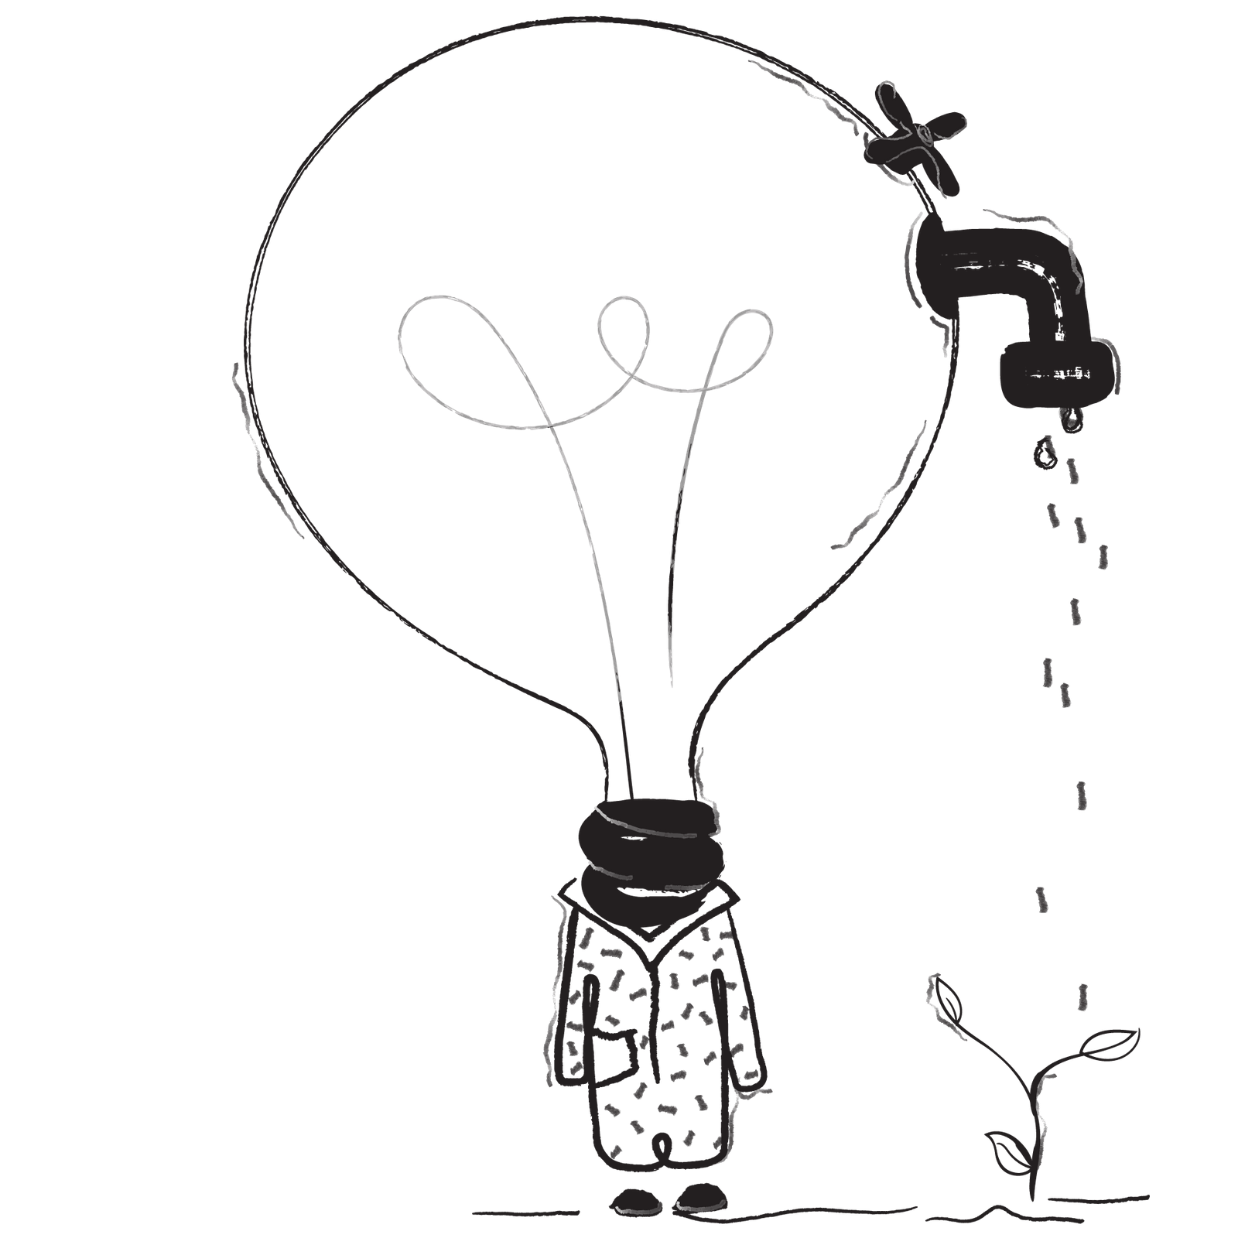
Capitalism and Socialism in the Modern Era
Many countries have mixed economies that incorporate elements of both capitalism and socialism
Role of the state in regulating the economy
Proponents of capitalism argue for minimal government intervention, critics argue it can lead to inequality and exploitation
Proponents of socialism argue for a greater role for the state, critics argue it can lead to inefficiency and lack of innovation
Global economic system has become increasingly interconnected, with multinational corporations operating across national borders and globalization increasing economic growth and prosperity for some, but also contributing to income inequality and environmental degradation
Recent resurgence of interest in socialist ideas, particularly among younger generations, fueled by concerns about income inequality, environmental degradation, and negative impacts of globalization
Capitalism remains dominant economic system, with many countries embracing free market principles and private enterprise

Slide 10
Pakistan has a mixed economy that combines elements of capitalism and socialism. It combines elements of a market-based system, in which prices are determined by supply and demand and private enterprise is allowed, with elements of a planned economy, in which the government plays a role in regulating the economy and providing certain public goods and services.
The government's role in regulating the economy can include activities such as setting monetary policy, regulating industries, providing subsidies and tax incentives, and owning and operating certain industries. Private enterprise is allowed to operate in areas such as agriculture, industry, and the service sector.
Pakistan's economic system has evolved over time, with a shift towards a more capitalist system in the 1980s and 1990s through the privatization of state-owned enterprises. This shift has led to increased economic growth, but also income inequality and a widening gap between the rich and the poor.
Economic System of Pakistan
Agriculture is a major contributor to the economy, accounting for around 22% of GDP and employing a large percentage of the workforce
Industry, including textiles and industrial goods, accounts for around 24% of GDP and is concentrated in urban areas
The service sector, including tourism, finance, and telecommunications, accounts for around 54% of GDP and is primarily concentrated in urban areas
Major economic challenges include poverty, unemployment, and inflation, and economic growth has been slow due to natural disasters, political instability, and security challenges

Slide 11
Suggested Economic System for Pakistan
It is important to consider the political, social, and economic circumstances of a country when determining the best economic system
There is no one-size-fits-all solution for all countries
Pakistan's Current Economic System
Mix of public and private ownership
Government plays a significant role in the economy
Large agricultural sector, growing industrial sector, and significant contribution from the service sector
Economic Reforms to Consider
Increasing productivity and entrepreneurship
Suggestions
Attracting foreign investment
Liberalizing trade, reducing regulations, and increasing access to credit
Infrastructure Development
Improving infrastructure such as roads, bridges, and ports can increase economic activity and facilitate the movement of goods and services
Investment in Human Capital
Improving education and healthcare can increase productivity and competitiveness
Choosing the Right Economic System
Ultimately, the decision of which economic system to adopt depends on the specific needs and circumstances of a country. It is important for Pakistan to carefully consider its options and choose the system that best fits its needs and goals.

Slide 12


Summary
Capitalism
Socialism
Definition
private ownership of the means of production and the creation of goods and services for profit.
public ownership of the means of production and distribution of wealth and resources for the benefit of all.
Ideas
Classical liberalism, libertarianism
Marxism, socialism
Political System
Representative democracy
Representative democracy, dictatorship of the proletariat
Key Proponents
Adam Smith, John Locke
Karl Marx, Friedrich Engels
View of the World
promotes competition and individual achievement through private ownership and a profit motive.
The world can only be made fair through collective ownership and control of the means of production and the elimination of class distinctions.
Philosophy
Classical liberalism, libertarianism
Marxism, socialism
Free Choice
Individual choice
Limited, based on the needs of society
Examples
United States, United Kingdom, Canada
Soviet Union, China, Cuba
Means of Control
Government regulation, market forces
Government control, worker control
Earliest Remnants
16th century Europe
19th century Europe
Private Property
Allowed
Limited or abolished
Social Structure
Market-based
Classless society
Ownership Structure
Private ownership
Collective ownership
Economic Coordination
Market forces
Central planning

Slide 13


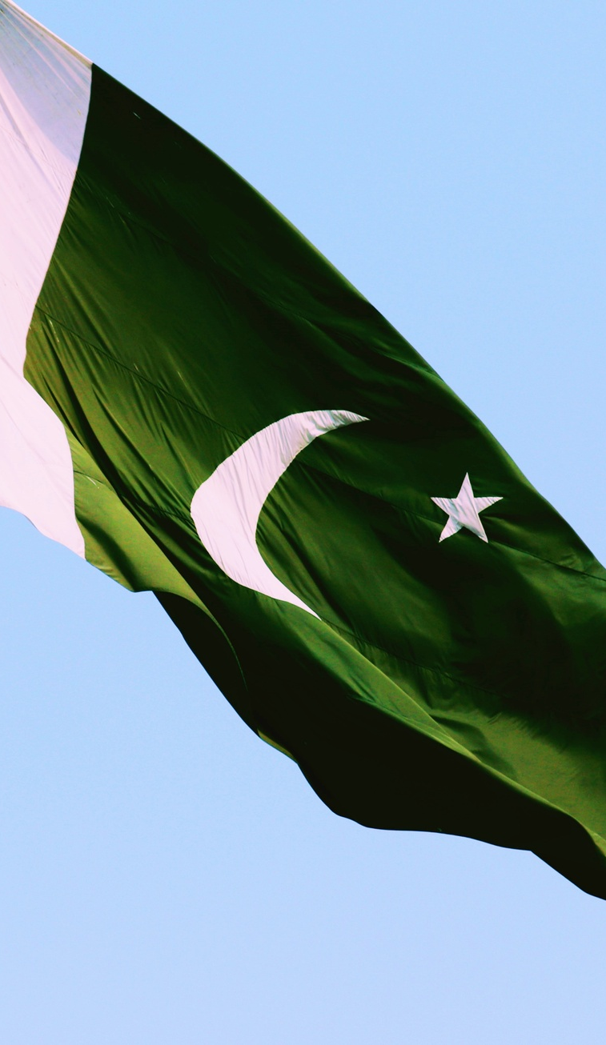
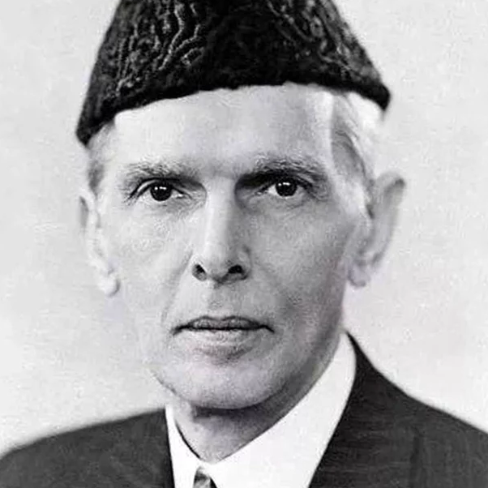
The economic system of the West has created almost insoluble problems for humanity and to many of us it appears that only a miracle can save it from disaster that is not facing the world. It has failed to do justice between man and man and to eradicate friction from the international field. The adoption of Western economic theory and practice will not help us in achieving our goal of creating a happy and contended people. We must work our destiny in our own way and present to the world an economic system based on true Islamic concept of equality of manhood and social justice.
Quaid-e-Azam

Slide 14

Any Questions?
Thank You!

